Slide 1

Poti po mreži
Predmet: Računalništvo
Avtor: Nik Jenič T4b
Mentor: Gregor Mede, univ. dipl. inž. rač. in inf.
Novo mesto, april 2022

Slide 2
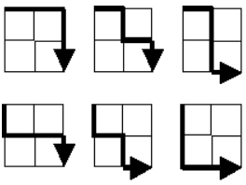
Project Euler in naloga
Programersko razmišljanje
Problem 15
(1,2)
(1)

Slide 3

Programski jezik Java
Zanesljiv
Preprosta grafika
Dobro dokumentiran
(4-10)
(3)

Slide 4
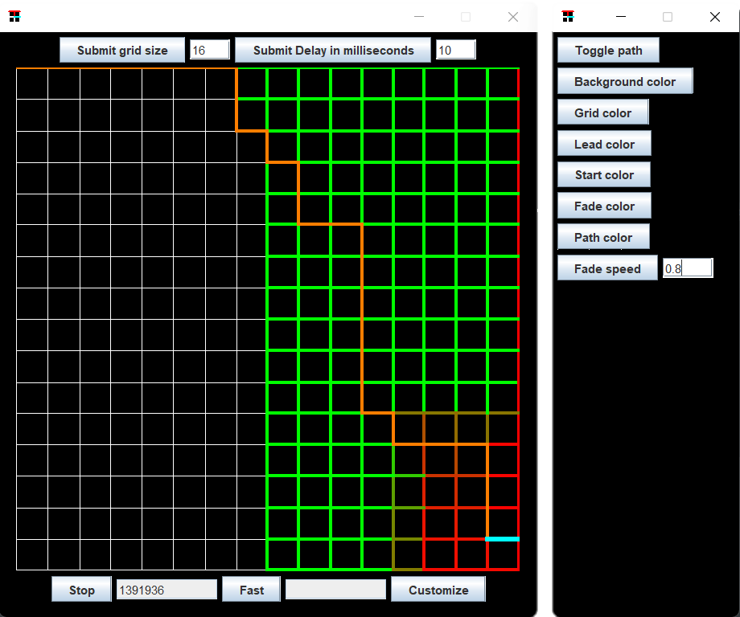
Končni izdelek
Prilagodljivost
Mreža
Praktičnost
(22)

Slide 5
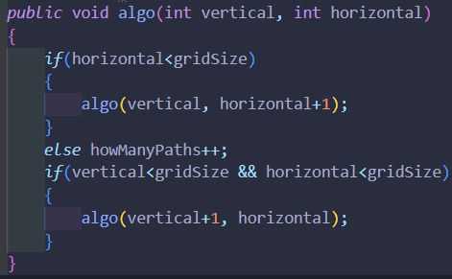
Algoritem
Rekurzivna metoda
(11)
(22)

Slide 6
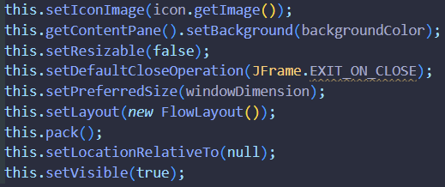
Okno in gumbi
javax.swing
JFrame (dedovanje)
JButton
JTextField
(12-15)
(22)

Slide 7
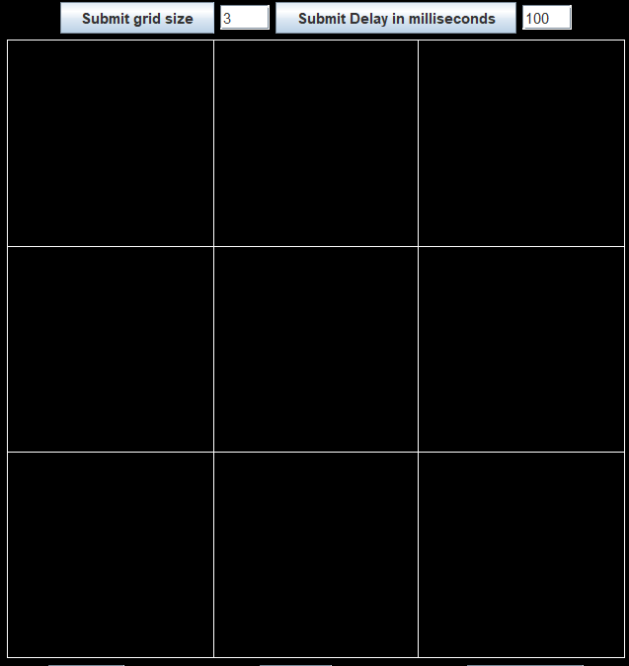
Mreža
JLabel
Runnable
paint()
Graphics2D
(12-15)
(22)

Slide 8
Izris poti
HashMap
Razred “Line”
Paint
Runnable
try-catch
(13,15,16)

Slide 9
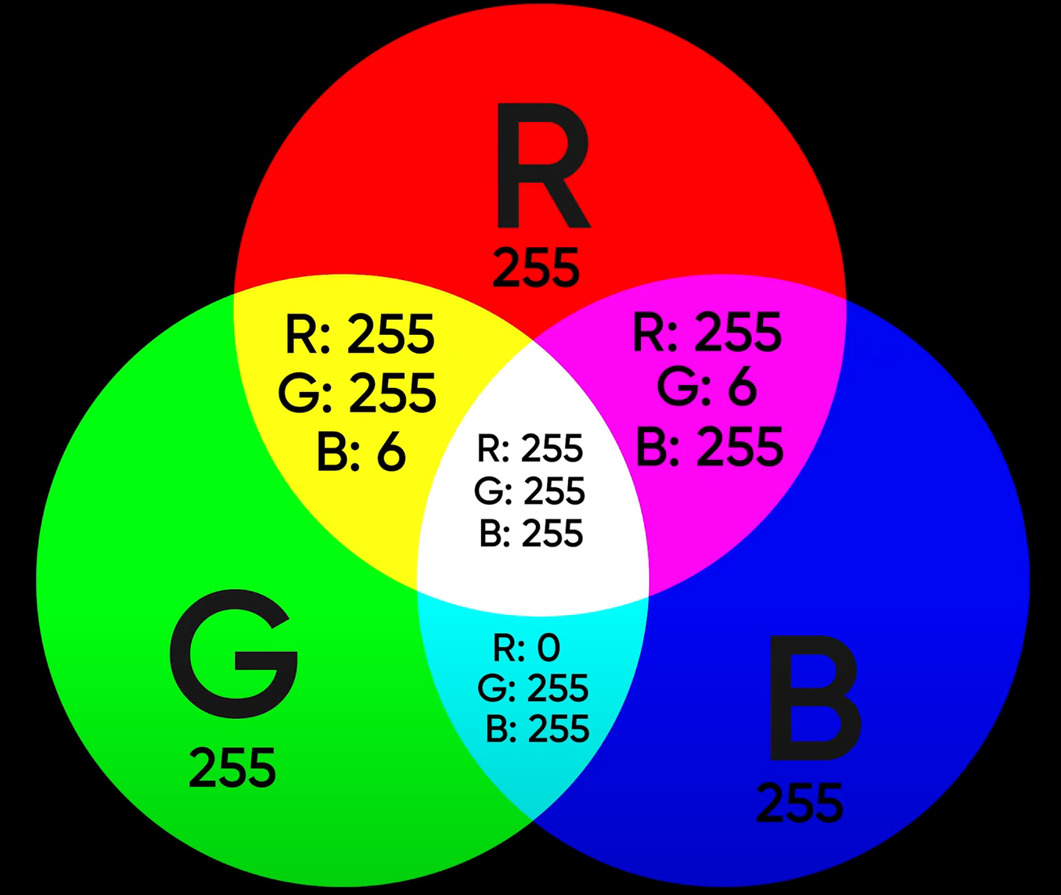
Animacija
RGB
java.awt.Color
(13,17,18)
(21)

Slide 10
Prilagoditveno okno
JFrame
(15,19)

Slide 11
Hiter rezultat
X – velikost mreže
(2*X)!/(X!*X!)
Tabele
(23)

Slide 12
Uporaba programa

Slide 13
Zaključek
Bolj optimizirana koda
Več niti pri algoritmu
Vgrajen BigInteger
Poglobil v Javo
(20)

Slide 14
Zahvala
Profesorju Gregorju Medetu
Prijateljem in družini

Slide 15
Viri
1: https://projecteuler.net/
2: https://www.educative.io/
3: https://logoeps.com/
4: https://www.statista.com/
5: https://www.java.com/
6: https://studentski.net/
7: https://www.stackchief.com/
8: https://kafka.apache.org/
9: https://www.geeksforgeeks.org/
10: https://studentski.net/
11: https://www.geeksforgeeks.org/

Slide 16
Viri
12: https://stackoverflow.com/
13: https://docs.oracle.com/
14: https://stackoverflow.com/
15: https://www.youtube.com/ - Bro Code
16: https://www.w3schools.com/java/
17: https://www.javatpoint.com/java-tutorial
18: https://www.rapidtables.com/
19: https://stackoverflow.com/
20: https://stackoverflow.com/
21: https://www.youtube.com/ - Linus Tech Tips
22: Izvorna koda: https://github.com/nik1178/LatticePaths
23: https://projecteuler.net/thread

